Slide 1
Zap/Fizzle
Class One

Slide 2
Electronics Vs. Electricity
Basic Electrical Theory
Basic Components
Basic Circuits

Slide 3
Electricity Vs. Electronics
Electrical Systems:
Use electricity to directly run a machine
Transport potential energy

Slide 4
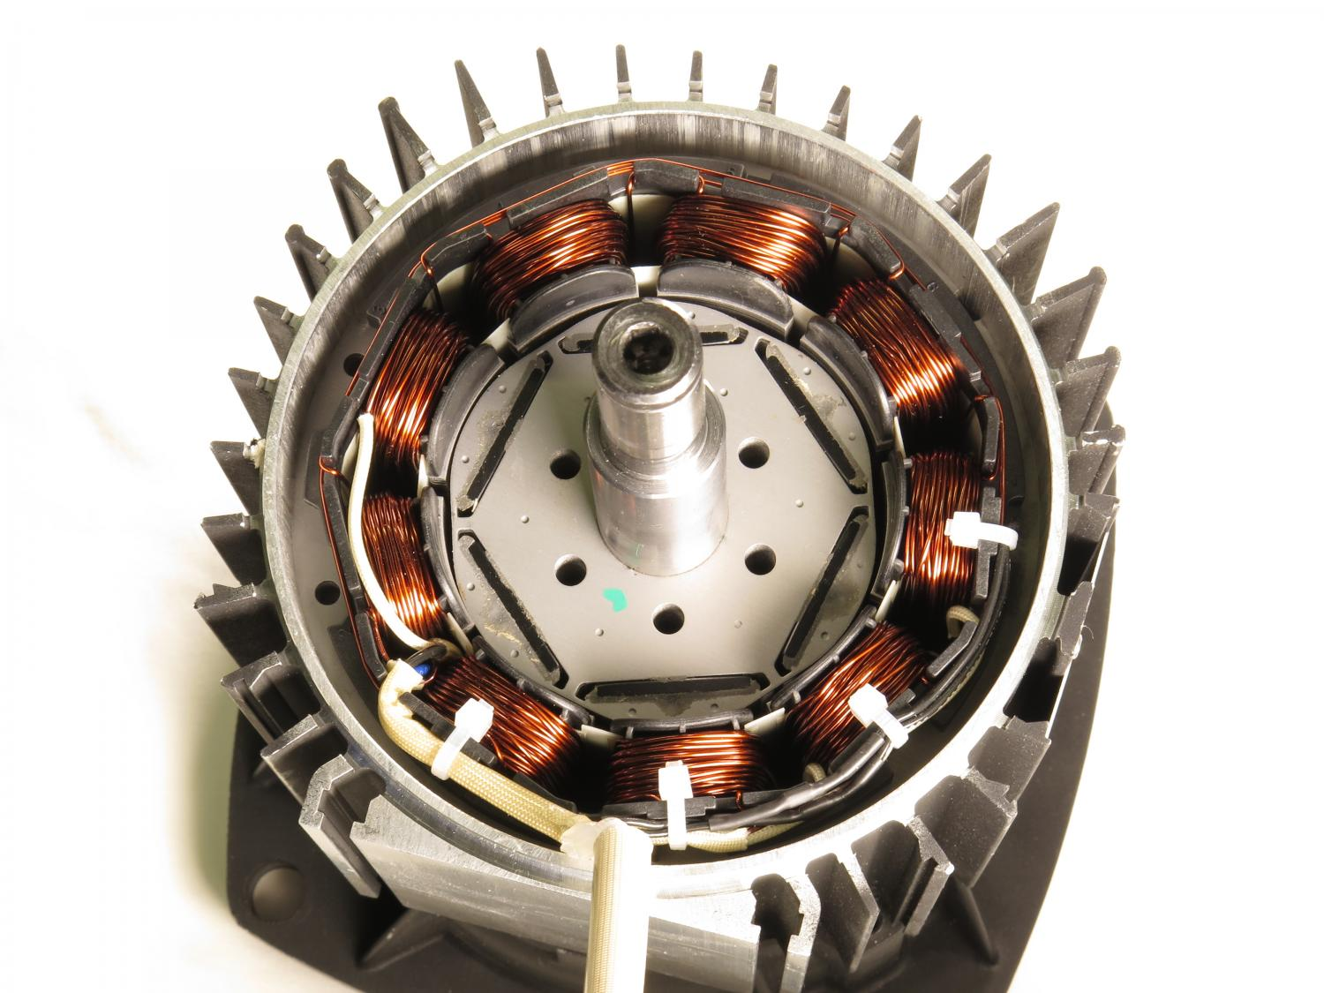
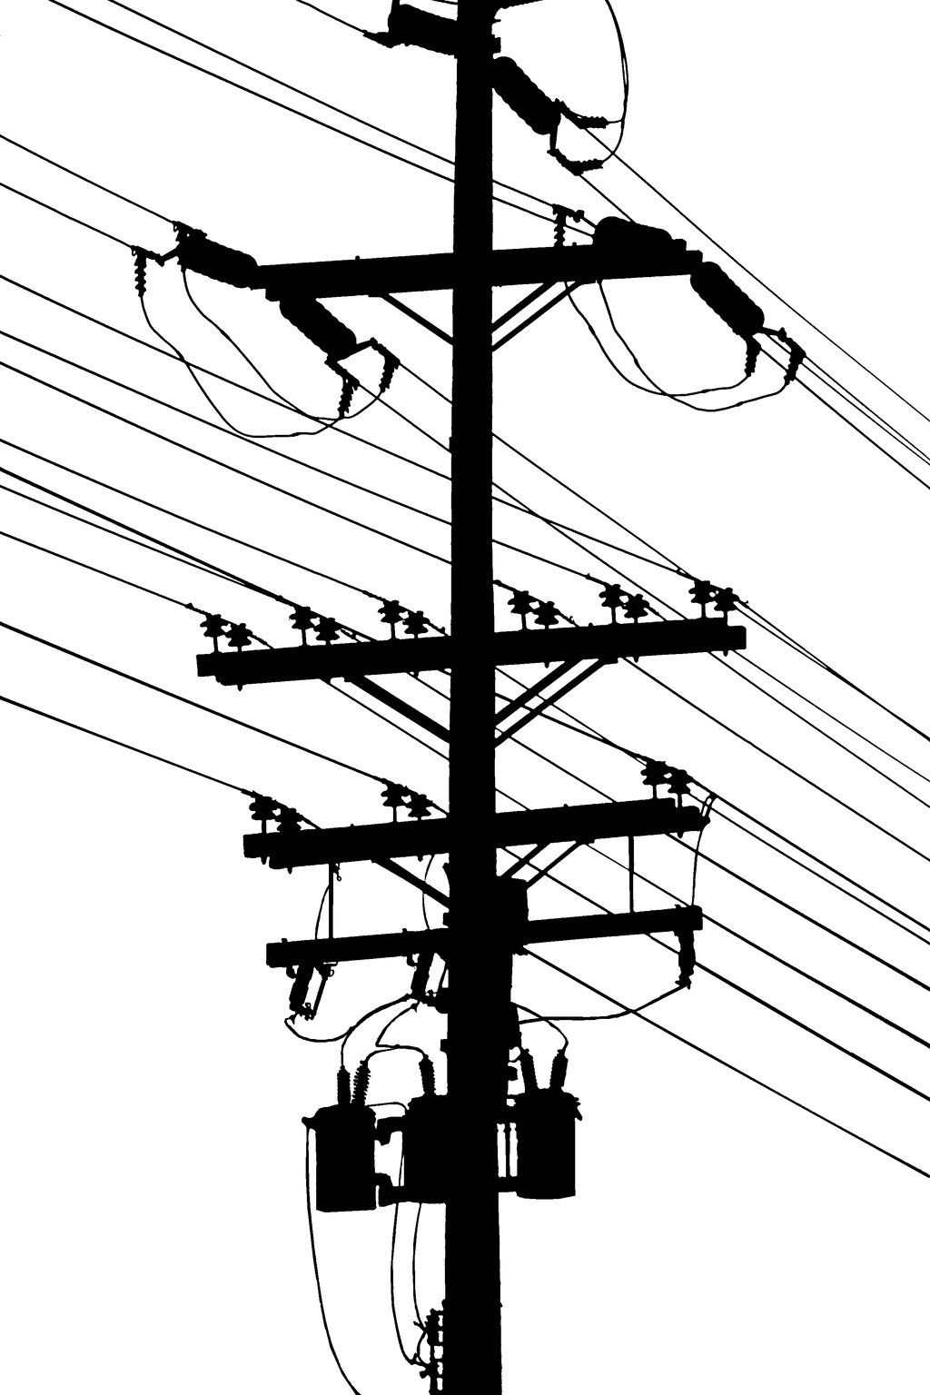
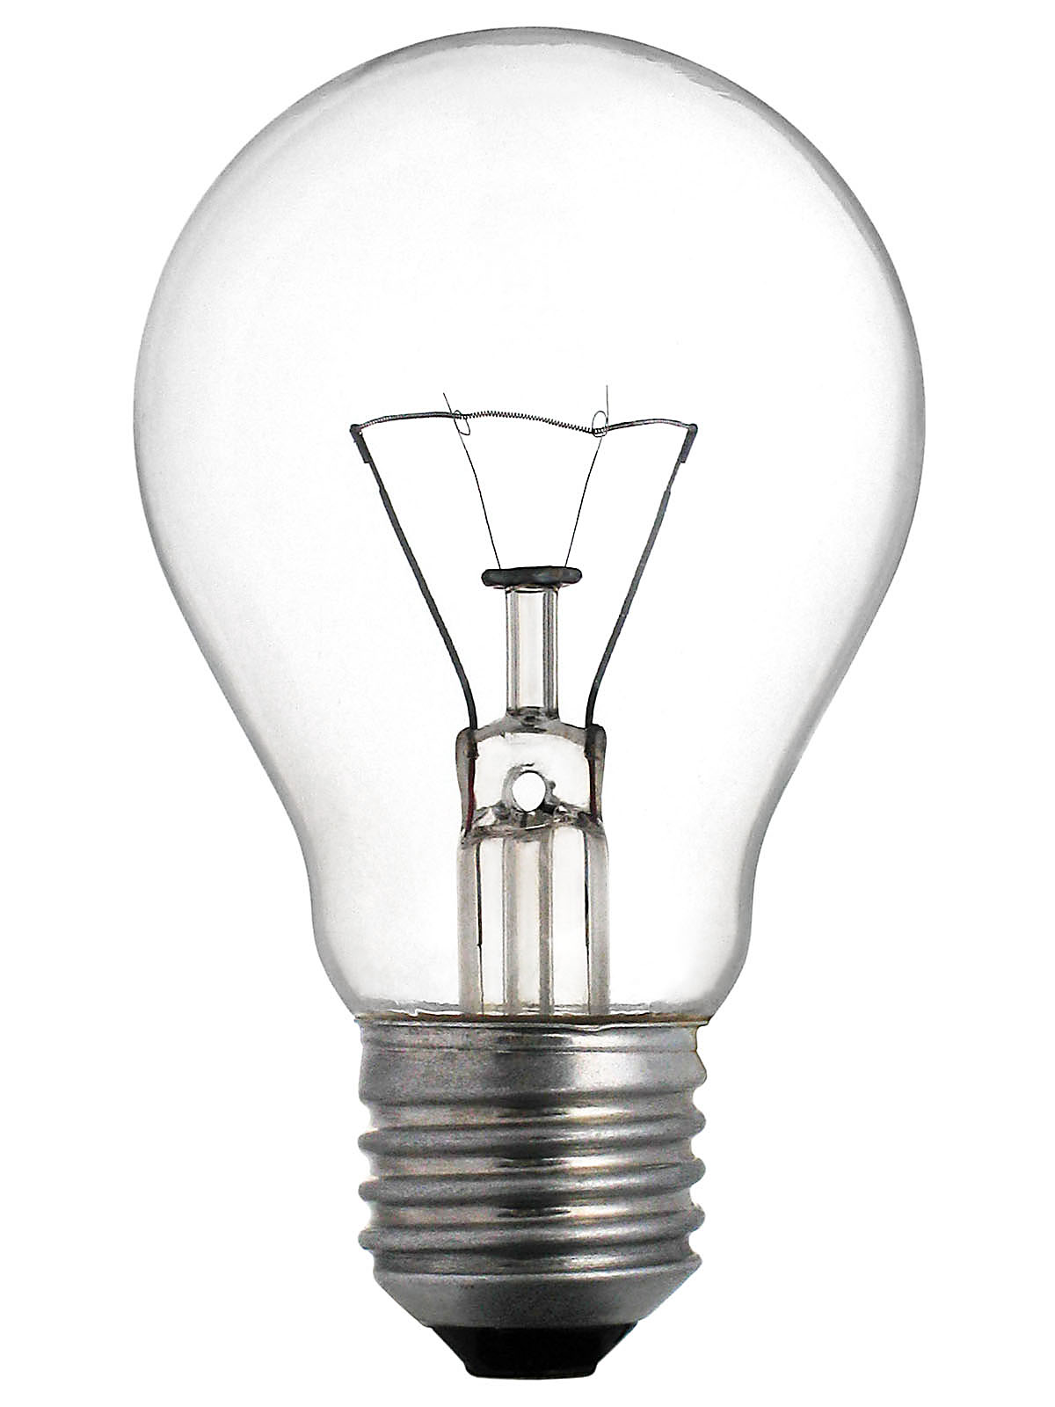
Electricity Vs. Electronics

Slide 5
Electricity Vs. Electronics
Electronic Systems
Use electricity to create a complex output based on input variables
Interpretation of experience based on a framework

Slide 6
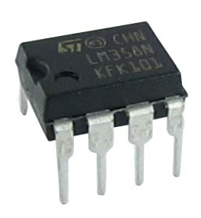
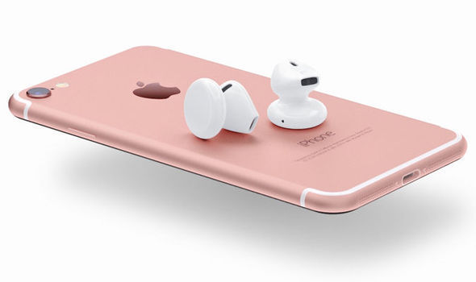
Electricity Vs. Electronics
Notes:
So obviously we’re pretty familiar with electronics.
OR ARE WE?!?!?!?

Slide 7
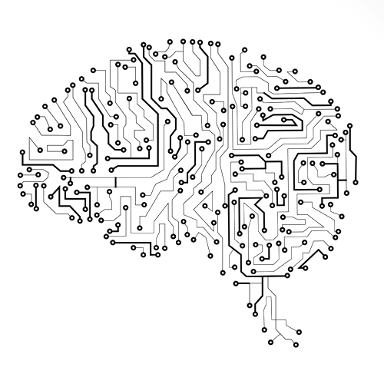
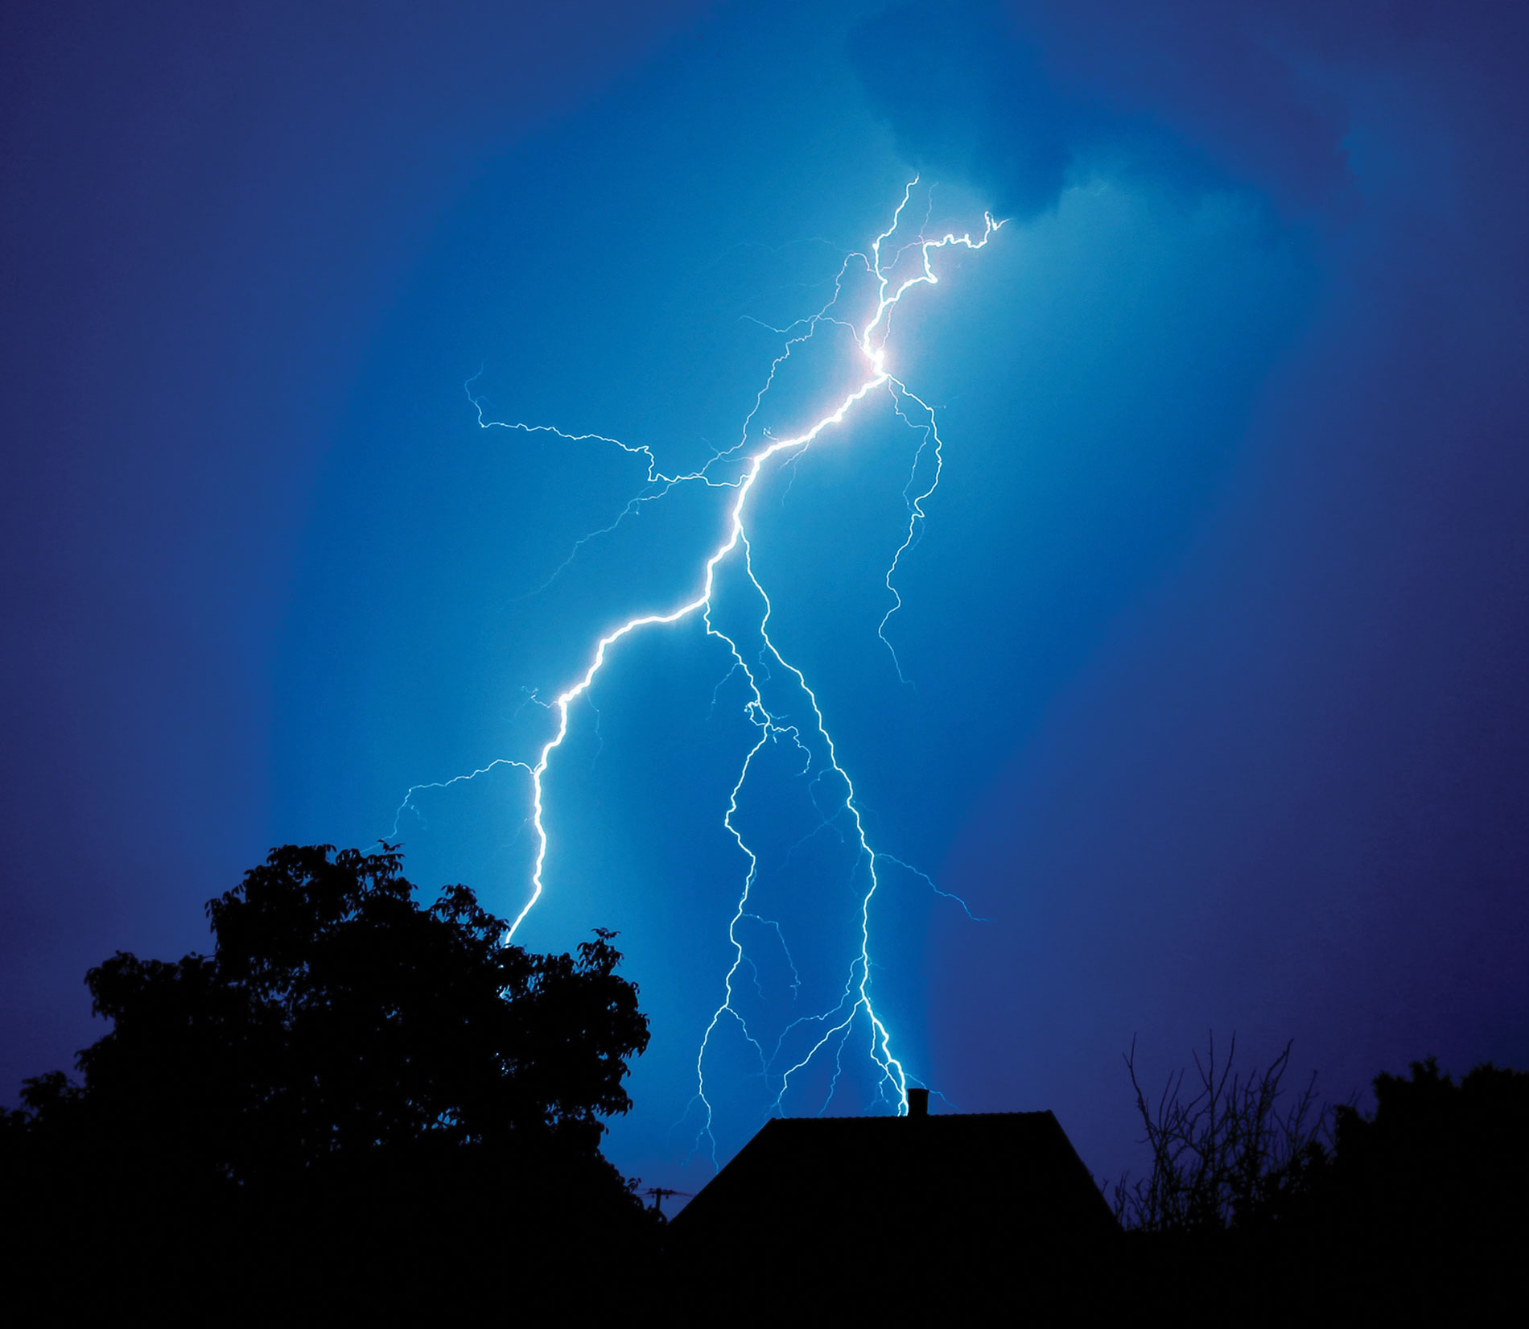
Electricity Vs. Electronics
vs
Notes:
Electricity is all around us, always. It is about natural paths.
Electronics are complex reactive systems made of electricity. Electronics are the thinking electricity.

Slide 8
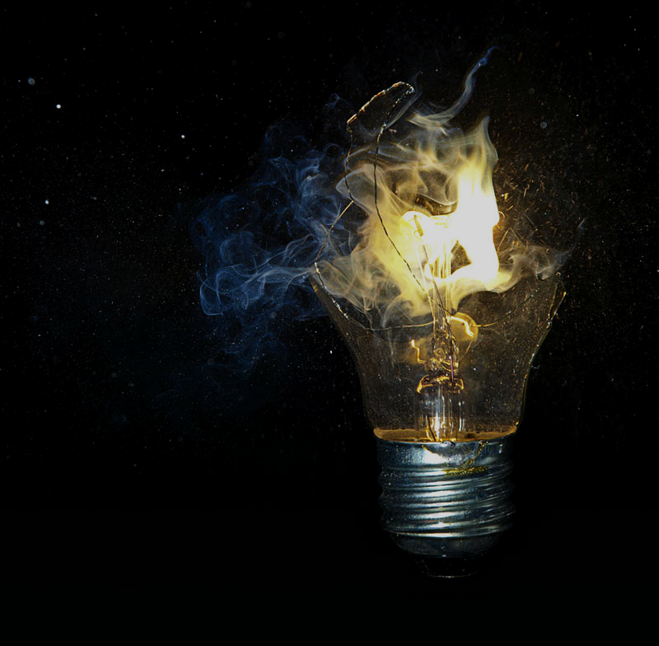
Magic?
Carl Sagan Disagrees...
Electricity...
...is the presence and flow of molecular energy (static vs current)
...requires a clear pathway to flow
...gets converted to other types of energy
...is completely predictable
...is inextricably connected to magnetism
Notes:
We’ll look at the relationship with magnetism when we look at motors.

Slide 9
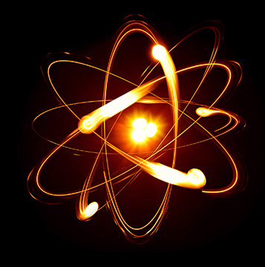
But Still...
HOW?
Atoms are the building blocks of the physical world.
They are made of a centre, nucleus, and surrounded by a negatively charged cloud made of electrons.

Slide 10
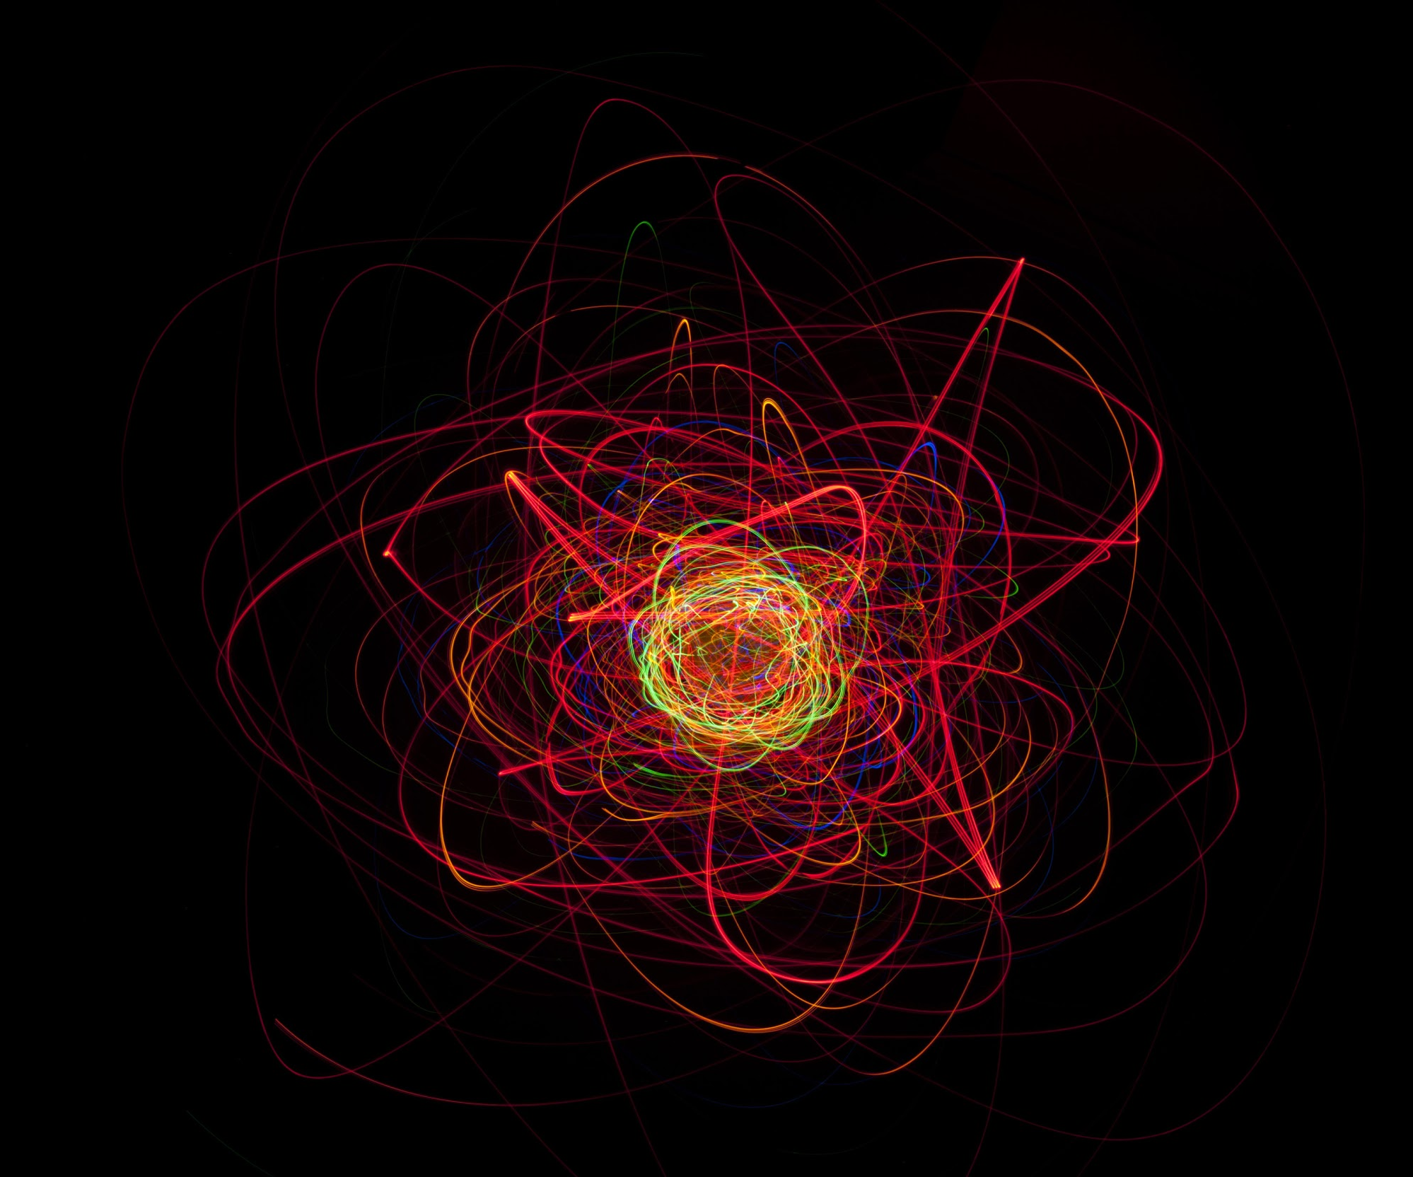
But Still...
HOW?
In reality, they are not so neatly ordered.
Notes:
We love Bohr, but his model of the atom is not accurate. They actually exist as clouds of probability… probably. Maybe.

Slide 11

But Still...
HOW?
I know exactly where the electron is, or how fast it's going. Never both.
Notes:
We love Bohr, but his model of the atom is not accurate. They actually exist as clouds of probability… probably. Maybe.

Slide 12
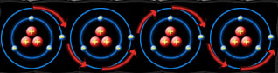
But Still...
HOW?
Atoms are the building blocks of the physical world.
They are made of a centre, nucleus, and surrounded by a negatively charged cloud made of electrons.
Being so negative, electrons look for any excuse to get away.
They move from atom to atom as space opens up for them.

Slide 13

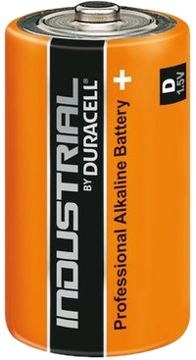
But Still...
HOW?

Slide 14
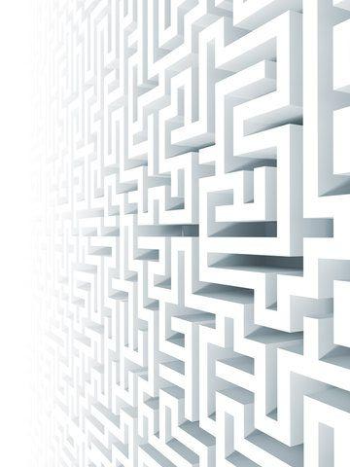
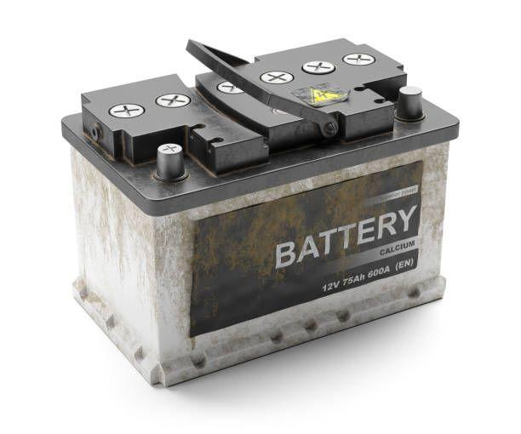
Even though they are Negative, Electrons still follow rules
I gotta get away

Slide 15

W-whhaaa?
Fffff!
Fine.

Slide 16
Even though they are Negative, Electrons still follow rules
I gotta get away
Not without
us you ain’t

Slide 17
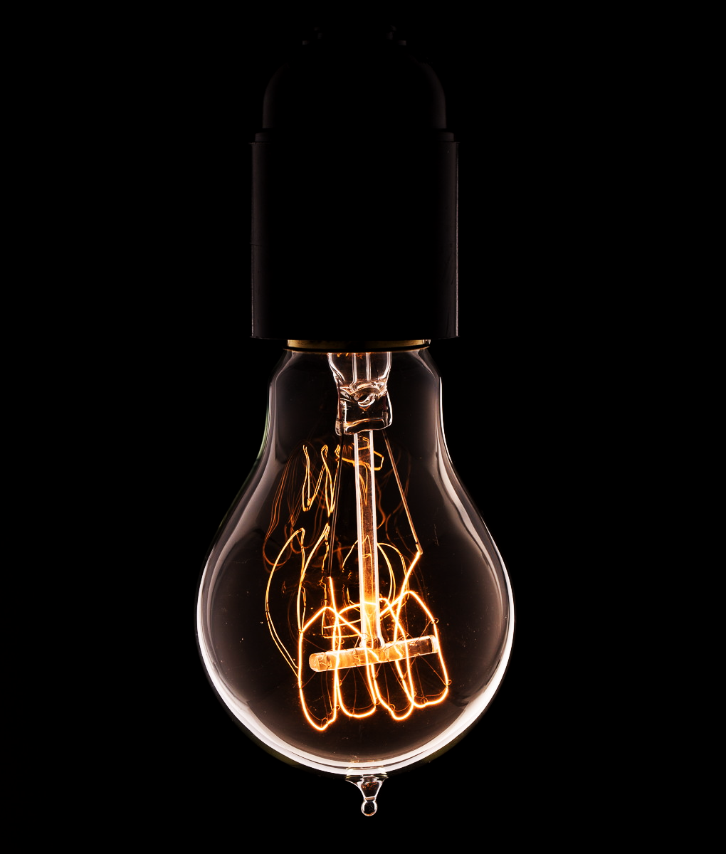
But Still...
HOW?
The movement of electrons flow through particular components, like a lightbulb.
This energy can then be converted into other things, heat, light, movement.
In electronics this movement causes complex machinery to operate, like molecular clockwork
Notes:
Common thinking Bohr’s method - electron is a particle with a well-defined mass revolving around the nucleus like a planetary system. more like a dense cloud of probability
Cation - An ion is an atom or group of atoms in which the number of electrons is not equal to the number of protons, giving it a net positive or negative electrical charge.

Slide 18
In particular
You still haven’t told me how it works

Slide 19
In particular
You still haven’t told me how it works
A Light bulb has a small wire running through it - the filament

Slide 20
In particular
You still haven’t told me how it works
A Light bulb has a small wire running through it - the filament
The leads coming into the filament are much thicker

Slide 21
In particular
You still haven’t told me how it works
A Light bulb has a small wire running through it - the filament
The leads coming into the filament are much thicker
The thinner filament causes friction with the electrons

Slide 22
In particular
You still haven’t told me how it works

Slide 23
In particular
You still haven’t told me how it works
The intense resistance on the electrons causes heat. This heat gives off radiant energy, running from visible spectrum light into IR. We can feel IR as heat on our skin. It’s all part of the same spectrum of electromagnetic energy!
It doesn’t burst into flames because there is no oxygen in the bulb - only inert gases (argon and nitrogen, usually)

Slide 24
In particular
You still haven’t told me how it works

Slide 25
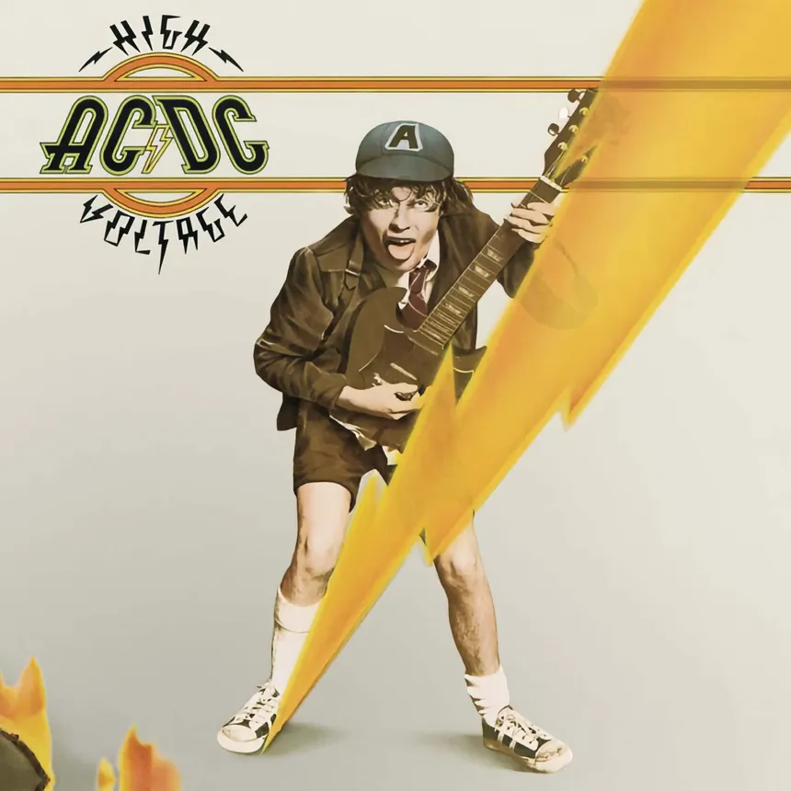
Electricity Vs. Electricity
AC=
Alternating Current
DC=
Direct Current
Notes:
Electricity is all around us, always. It is about natural paths.
Electronics are complex reactive systems made of electricity. Electronics are the thinking electricity.

Slide 26
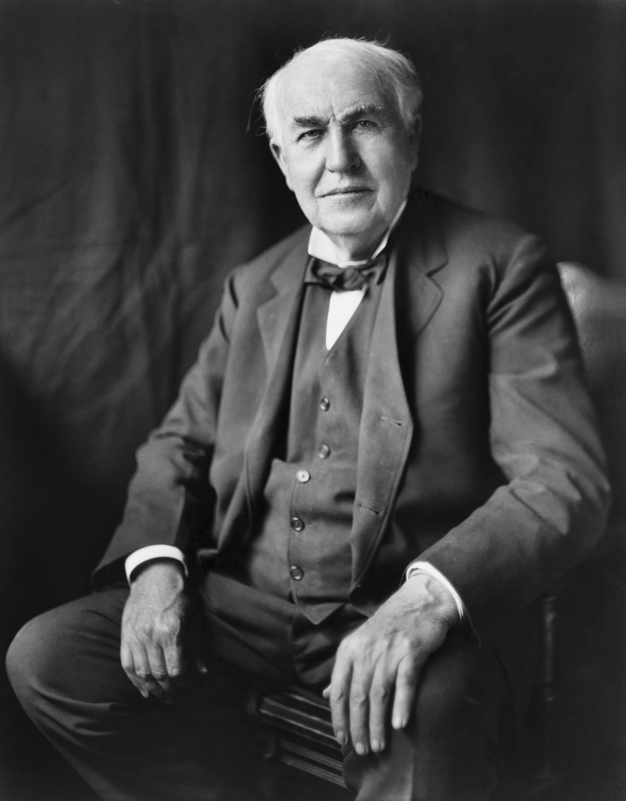
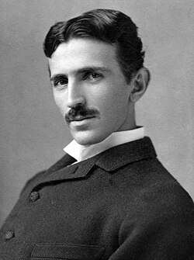

Electricity Vs. Electricity
Edison
~Vs~
TESLA
~Vs~
Notes:
Back in the 1890s the race was still on to establish the eletrical framework
The fight was using AC or DC.
He also funded the development of the electric chair which used AC to show the dangers
He also stiffed Tesla 50k for redesigning his DC dynamos ("Tesla, you don't understand our American humor").

Slide 27
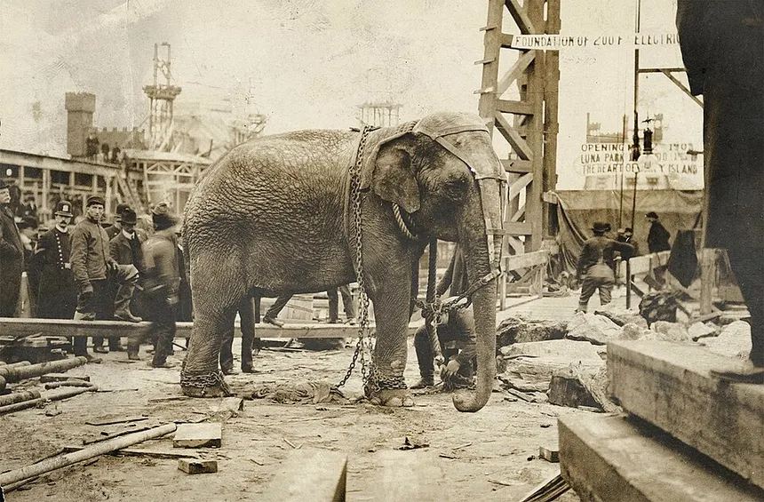
Electricity Vs. Electricity
My Fate is sealed.
I don’t blame Edison
Notes:
Topsy the Elephant was eletrocuted 1903, Luna Park NY.
Edison’s film studio—Edison Manufacturing Co.—sent a camera crew to document the spectacle, releasing the gruesome 74-second actuality film Electrocuting an Elephant for coin-operated kinetoscopes.
Edison did fry plenty of other things though -
Edison wanted DC to rule and tried to prove how dangerous was by electocuting stray dogs and cats, as well as horses.

Slide 28
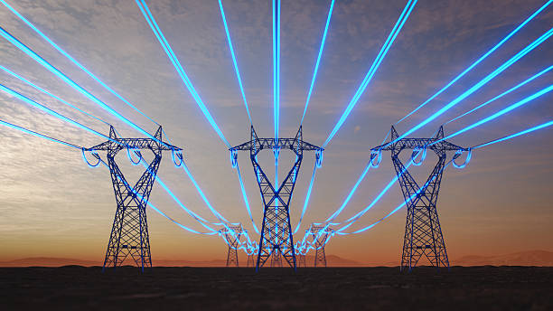
Electricity Vs. Electricity
Why was Edison stupid?
These would melt, carrying the current DC power requires to run a city. AC works.
(Also he was just kind of a dick.)
Notes:
As mentioned current is the flow of electrons.
DC Current is linear.
AC changes direction of flow periodically. In common vernacular periodically means occasionaly, but in electrical systems it mean of a period – a rhythm

Slide 29
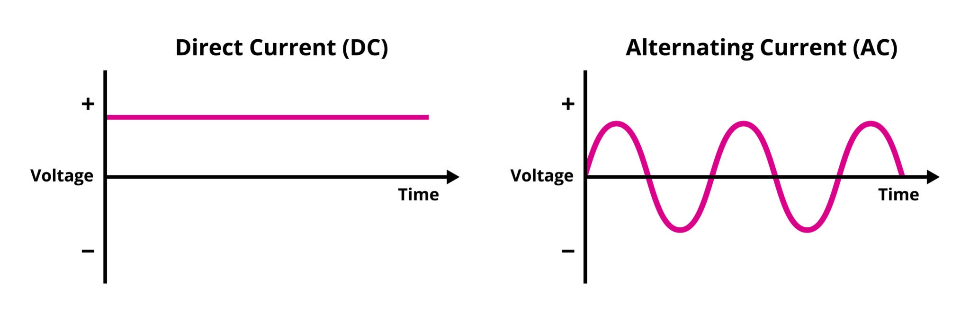
Electricity Vs. Electricity
But what is it?
Notes:
As mentioned current is the flow of electrons.
DC Current is linear.
AC changes direction of flow periodically. In common vernacular periodically means occasionaly, but in electrical systems it mean of a period – a rhythm

Slide 30

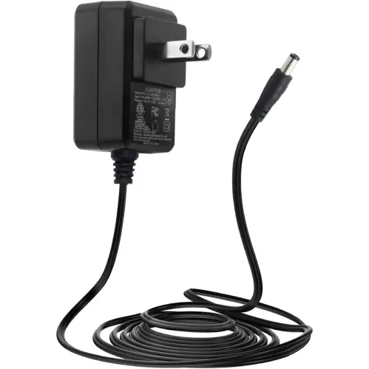
Electricity ♡ Electricity
I’m a flippin’ superhero!
How do we make it work for us?
Notes:
As mentioned current is the flow of electrons.
DC Current is linear.
AC changes direction of flow periodically. In common vernacular periodically means occasionaly, but in electrical systems it mean of a period – a rhythm

Slide 31
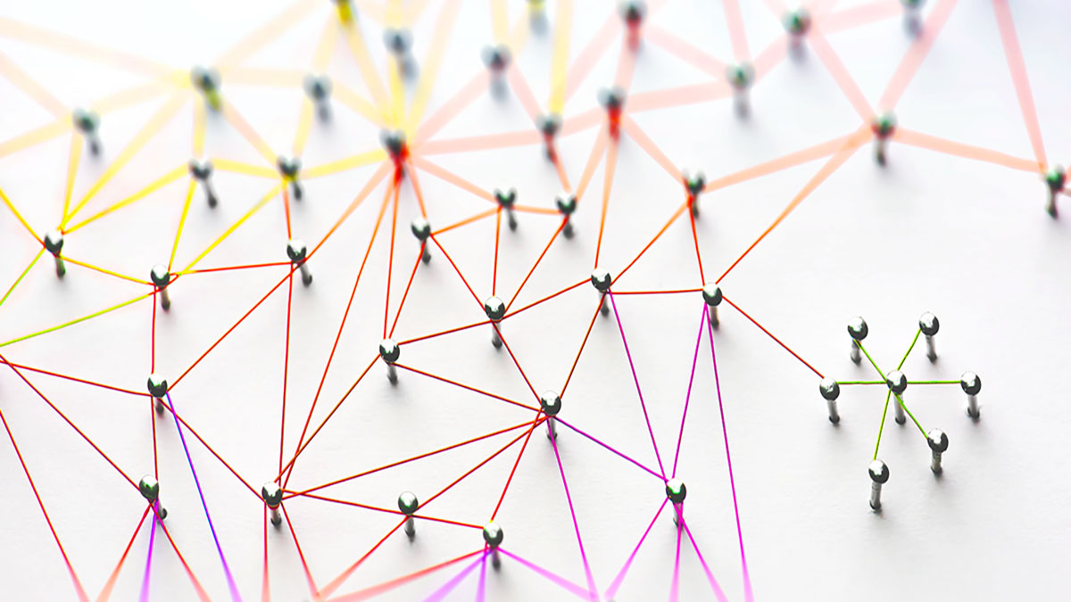
Pathways
This is going to come up again and again.
Notes:
We always need to think about connections

Slide 32
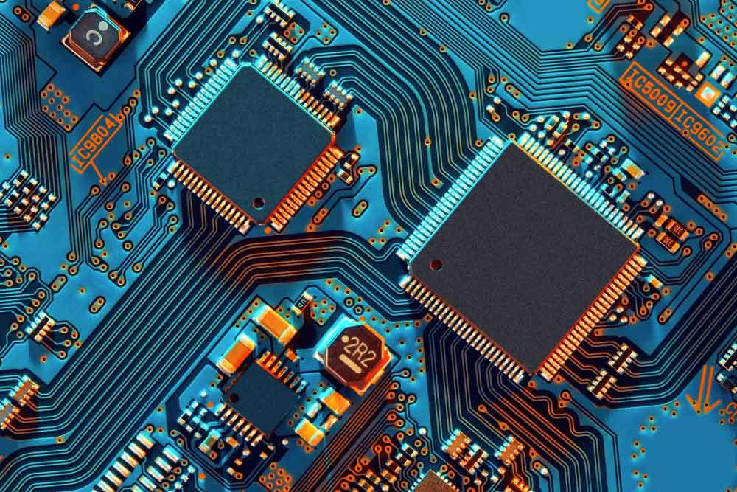
PATHWAYS CAN BE VERY COMMPLEX

Slide 33
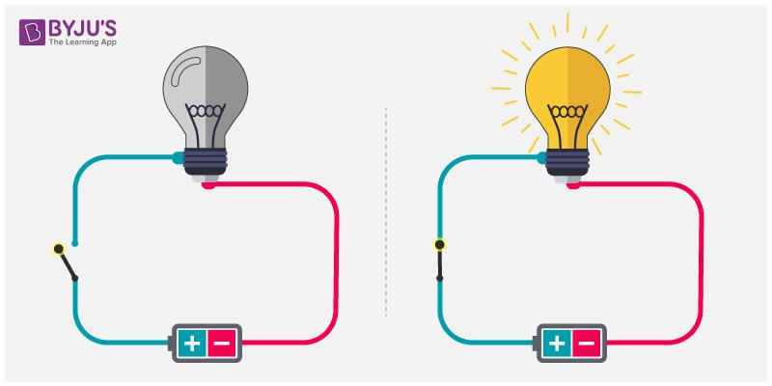
Stop Hyperventilating
We’re going to start pretty simple. Think about one or two components, how do we make them work?
Sometimes the light just won’t come on - why not?
You will have to stop and consider what is happening in your circuit.
Often it’s because it’s just not connected. Always trace connections back - make sure they are what you think they are!
X
=)

Slide 34
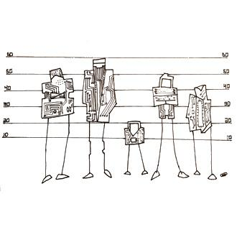
IT’s the centre one
It’s also possible the thing is connected, but electricity is finding a route around it - this is called a short circuit.
Like most of us, electricity will always take the easiest route. The path of least resistance.
But how does electricity move in a circuit?

Slide 35
Which way would YOU rather go?
Electricity will ALWAYS find the shortest route to complete the circuit, even (or maybe especially) if it means bypassing the loads in a circuit.

Slide 36

The Water Analogy
There really is no escaping it
Behold! The world’s crappiest watter tower!
The tap is off. No watter flows. This sucks.

Slide 37
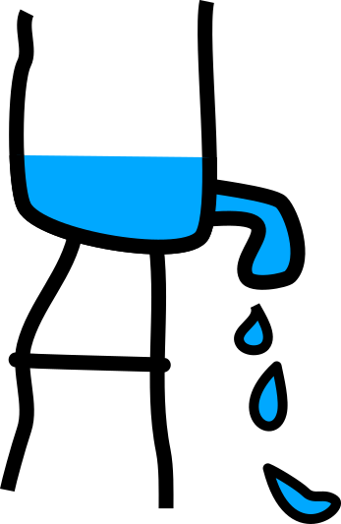
The Water Analogy
There really is no escaping it
Behold! The world’s crappiest watter tower!
The tap is off. No watter flows. This sucks.
Huzzah! The tap is on! Watter flows freely!
… Somewatt freely. There isn’t much pressure. Flow is slow. Watt can we do?

Slide 38
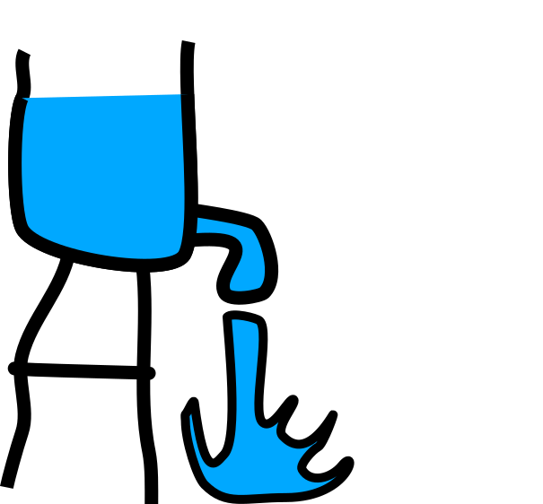
The Water Analogy
There really is no escaping it
Double huzzah! Extra watter has increased pressure! Now there is a righteous splooge of watts. Watt? Watt is going on here?

Slide 39
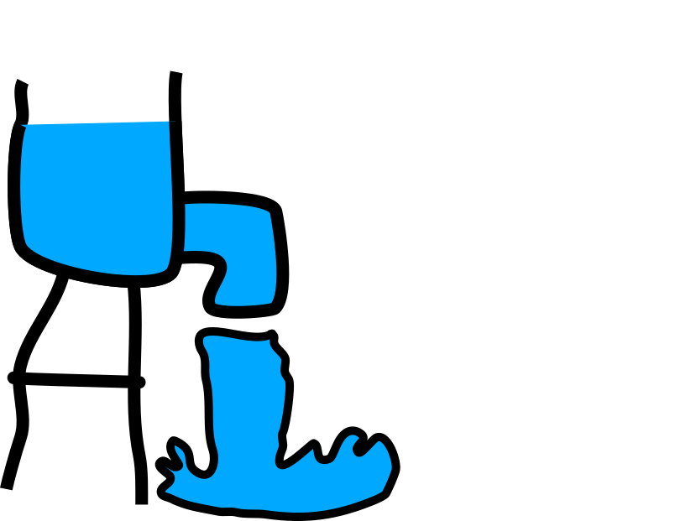
The Water Analogy
There really is no escaping it
Currently we’ve increased the pipe. Moar watter!
I am so amped up right now! Splain how this all works!

Slide 40
The Water Analogy
Volume/height of watter, affects pressure of splooge. Force = Volts
The shocking results
Size of outlet, affects capacity of splooged at any given moment.
Amount able to pass through = Amperes
Resultant splooge.
Watts

Slide 41
The Water Analogy
Watts = Volts x Amps
Volts = Watts / Amps
Amps = Watts / Volts
Simple math is simple!
Ohm my god!
Notes:
We will revisit this with real numbers and ways of measuring them!

Slide 42
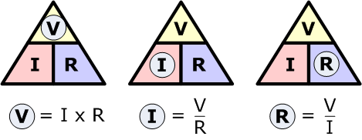
Mathematical!

Slide 43
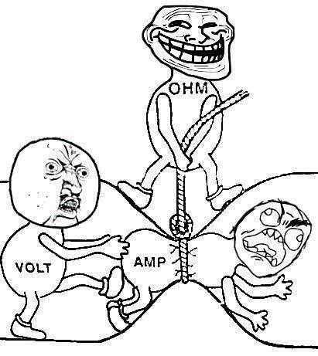
Mathematical!
Notes:
Two more ways to visualize the power relationship.

Slide 44

Bits + Pieces
Stuff makes it Work
We know current flow requires a pathway.

Slide 45
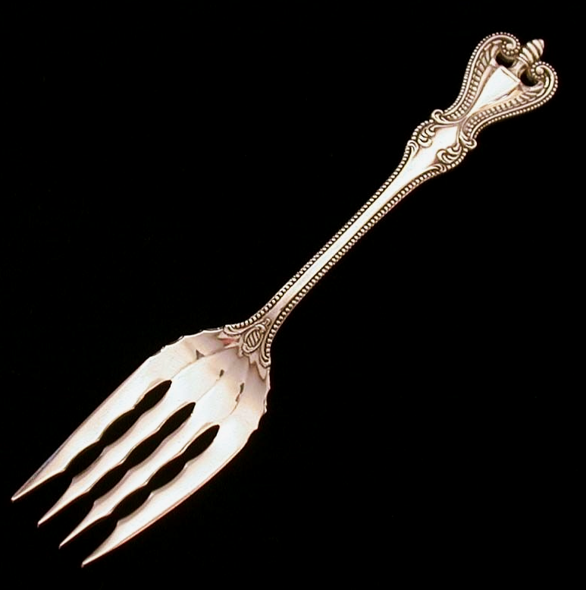
Bits + Pieces
Stuff makes it Work
We know current flow requires a pathway.
This pathway is usually made of highly conductive material.

Slide 46
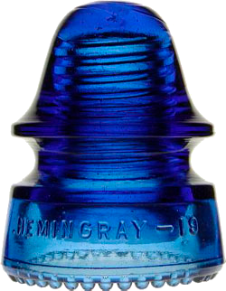
Bits + Pieces
Stuff makes it Work
We know current flow requires a pathway.
This pathway is usually made of highly conductive material.
The opposite of conducting is insulating, this impedes the flow of current.

Slide 47
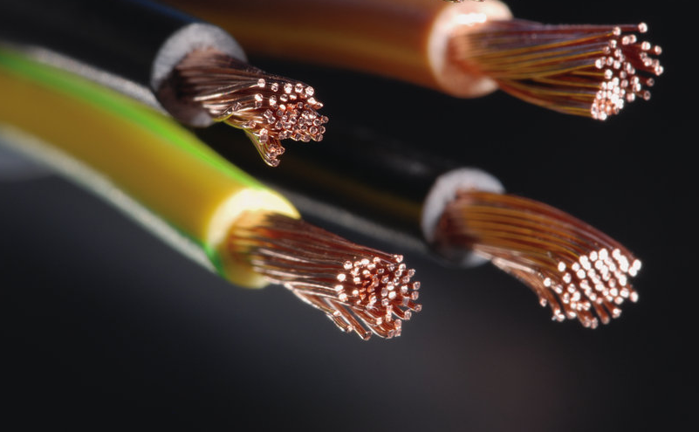
Bits + Pieces
Stuff makes it Work
We know current flow requires a pathway.
This pathway is usually made of highly conductive material.
The opposite of conducting is insulating, this impedes the flow of current.
A wire is usually a highly conductive material encased in an insulator
Notes:
Copper, Silver, Gold. All the junk we like to make jewellery from makes great electrical conductors!
We have to balance creating pathways for electricity with controlling the flow in different ways.

Slide 48

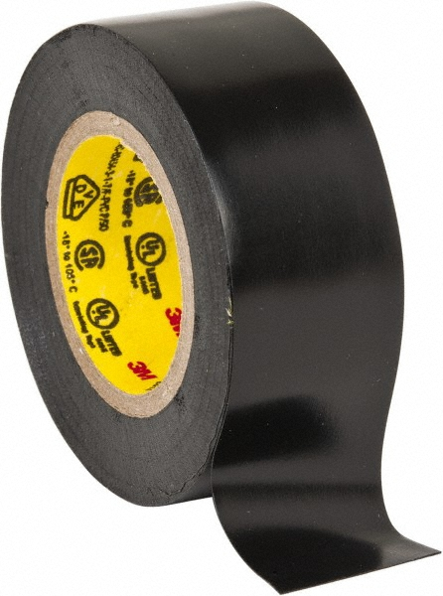
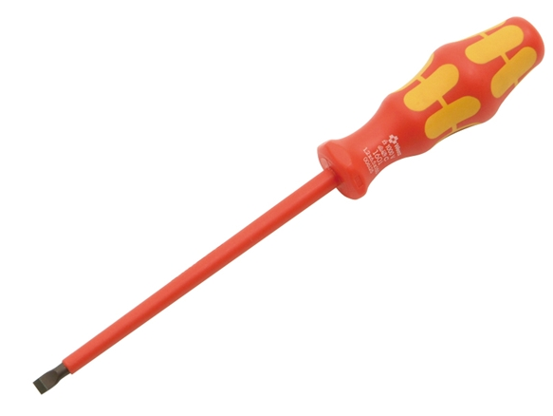
Other Insulators
“Keepy safies” and “Get in the wayies”
Vinyls, plastics, rubbers

Slide 49
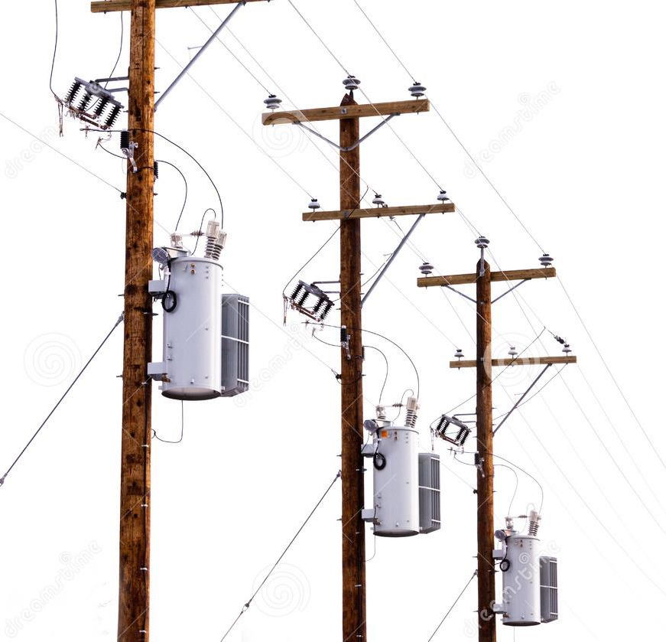

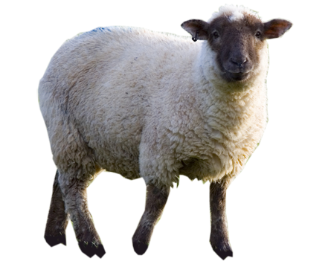
Other Insulators
“Keepy safies” and “Get in the wayies”
Vinyls, plastics, rubbers
Fibrous material

Slide 50
Other Insulators
“Keepy safies” and “Get in the wayies”
Vinyls, plastics, rubbers
Fibrous material
Vitreous & ceramic material

Slide 51
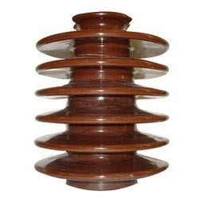
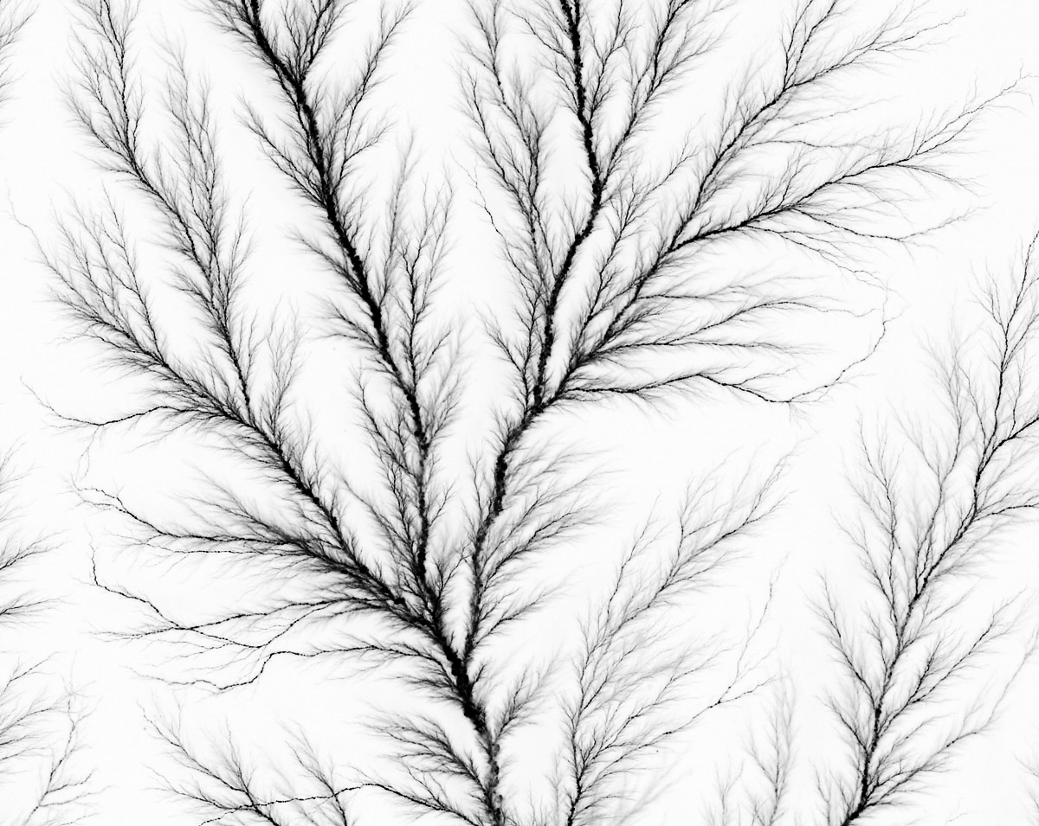
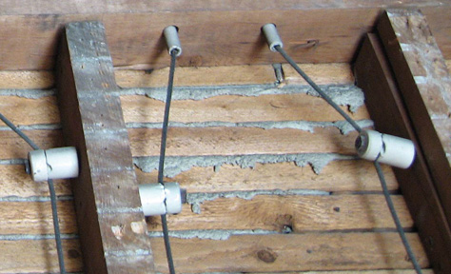
Other Insulators
“Keepy safies” and “Get in the wayies”
Vinyls, plastics, rubbers
Fibrous material
Vitreous & ceramic material

Slide 52
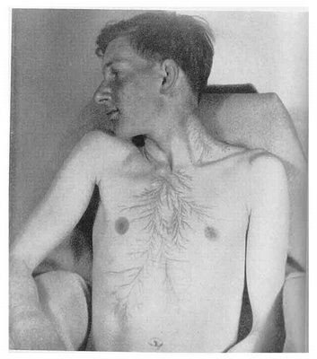
Other Insulators
“Keepy safies” and “Get in the wayies”
Vinyls, plastics, rubbers
Fibrous material
Vitreous & ceramic material
Skin?
Notes:
Fibrous material (wood, paper, hair, wool, silk)
-Lichtenberg marks from lighting strike.

Slide 53
Electrical Pathways
Heart attack in a can
Basically any metal
… Just add water
Can disrupt biological processes
Notes:
Voltage breakdown
https://www.youtube.com/watch?v=9iKD7vuq-rY

Slide 54
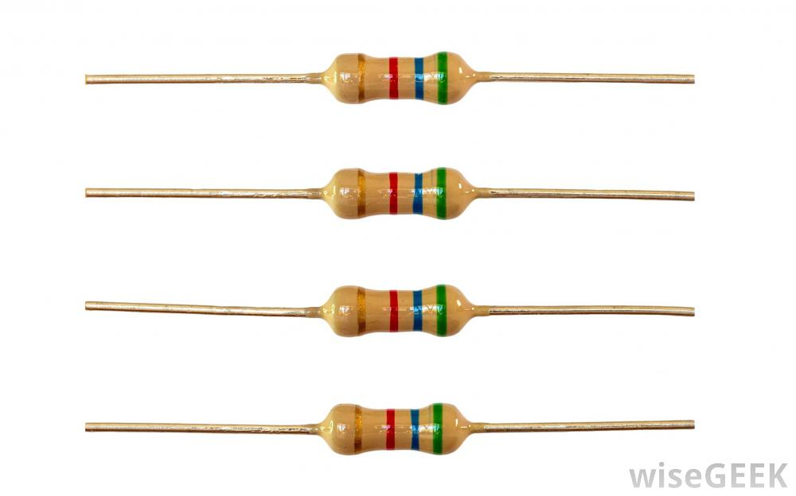
Bits N Pieces
Like Lego, but more electrocutiony
Resistors reduce or redirect the current flow precisely.
Colour bands indicate value of resistance
Not polarized

Slide 55
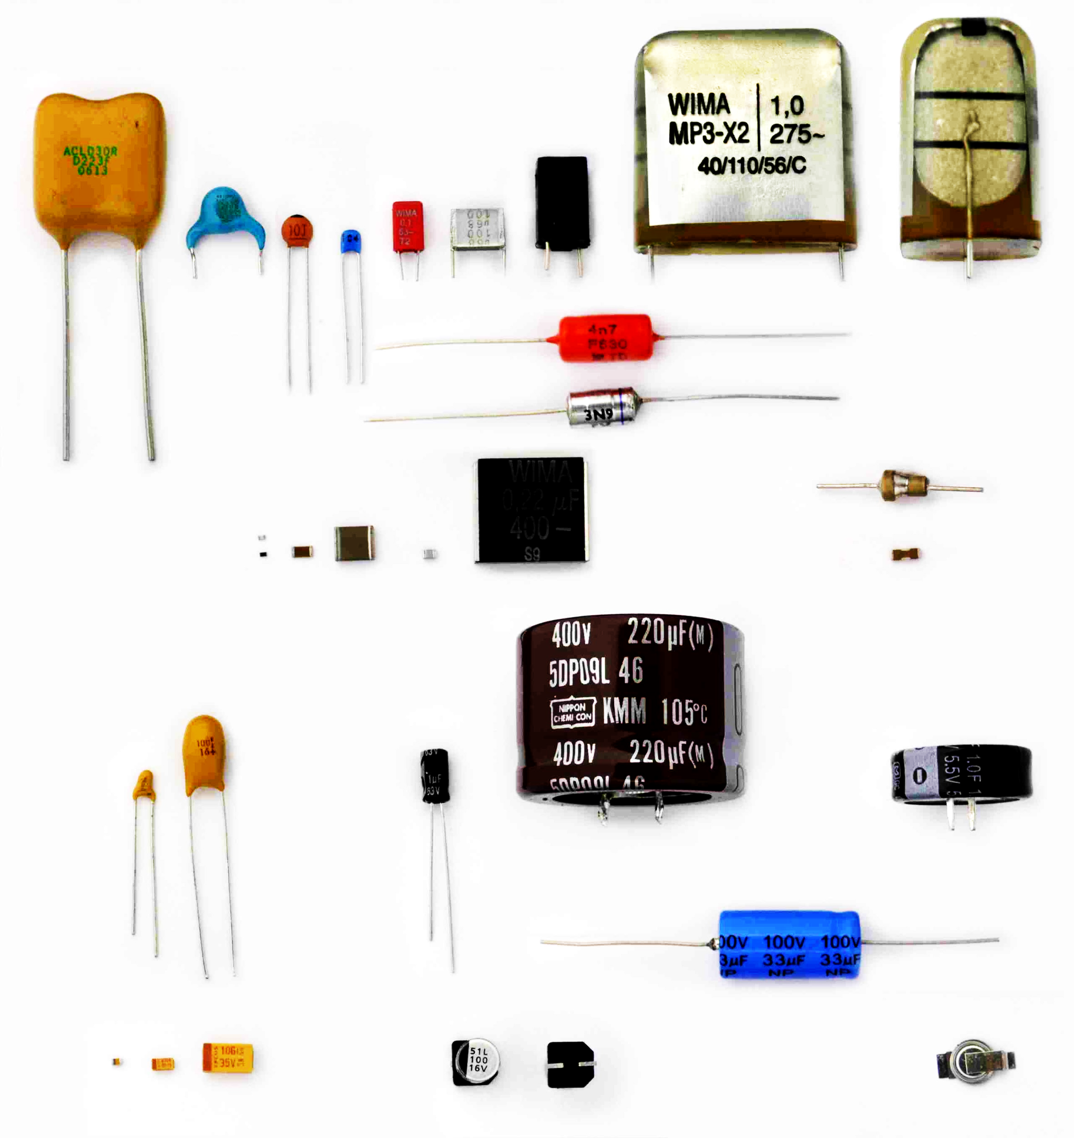
Bits N Pieces
Like Lego, but more electrocutiony
Capacitors store electricity
Some, but not all polarized

Slide 56
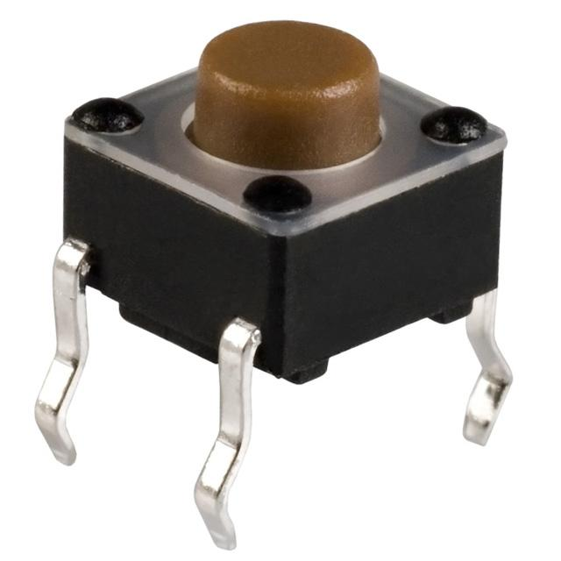
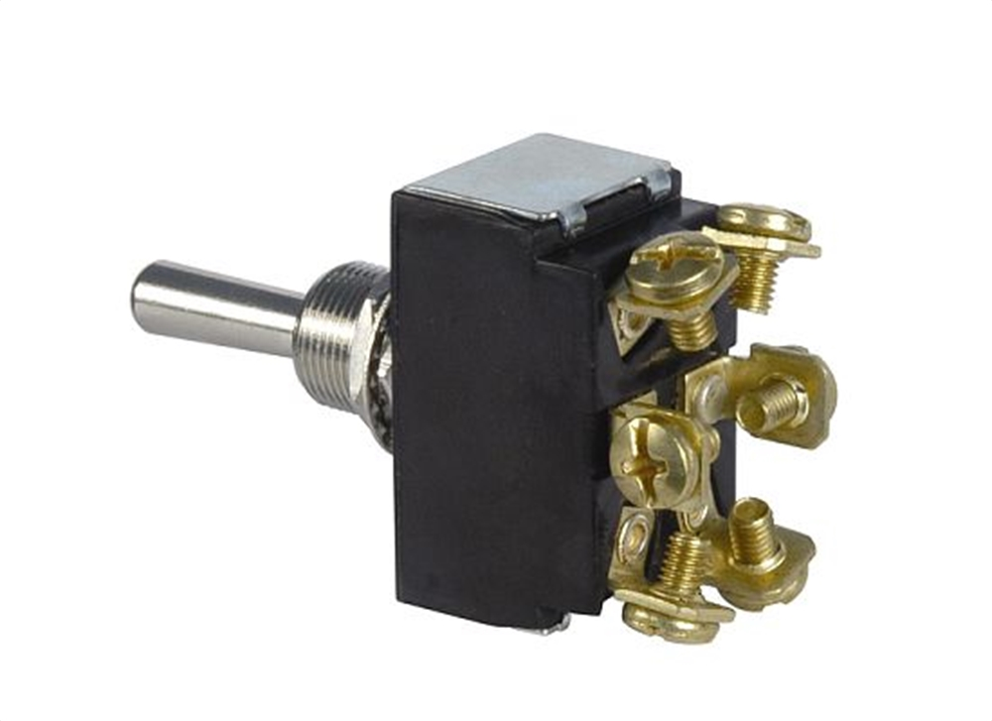
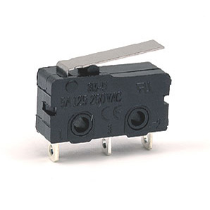
Bits N Pieces
Like Lego, but more electrocutiony
Switches open or close electrical pathways (change its state)
Some have multiple states

Slide 57
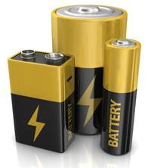
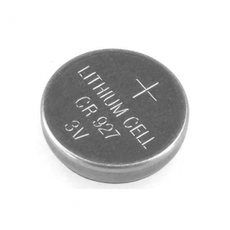
Bits N Pieces
Like Lego, but more electrocutiony
Batteries store and provide running electricity
Always polarized

Slide 58
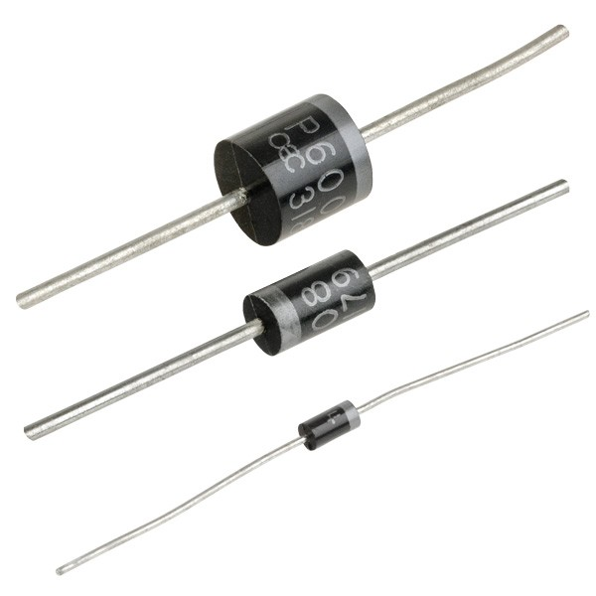
Bits N Pieces
Like Lego, but more electrocutiony
Diodes allow current to pass in one direction only
Cover a huge range of functions including signal transmission, voltage protection and regulation...

Slide 59

DIODES!!
Allow electricity to flow in one direction only

Slide 60

DIODES!!
...some can also produce electrical current from light!

Slide 61

DIODES!!
Light Emitting DIODES!!
...some can also produce light from electricity!
Yay LEDS!

